Slide 1
SteganoCrypt Tool

Slide 2
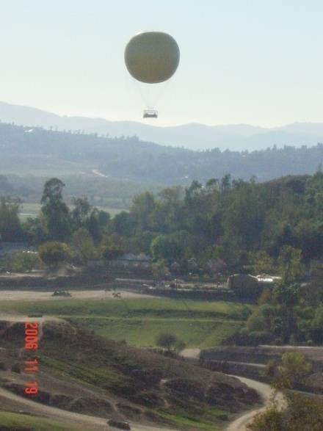
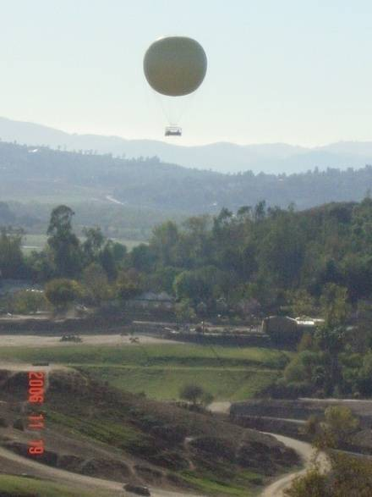
What is Steganography ?
The art and science of hiding information in a cover document such as digital images in a way that conceals the existence of hidden data.
Hiding data
Cover Image
Stego Image

Slide 3
Historical & Modern-Day Examples
Steganography comes from the Greek and literally means, "Covered writing
Tattoo on a Shaved Head
Invisible Ink: milk, lemon juice, vinegar
Microdot: a photograph the size of a printed period having the clarity of a type-written page.
Null Ciphers: take the n-th letter of each word in a passage in a book, magazine, etc.

Slide 4
Why Image Files?
Digital image data contains a great deal of redundant information (high capacity)
Unlike audio or video, typically no copyright issues to arouse suspicion
However, audio and video files have greater capacity than digital images
Researchers discourage use of clip art, images with text, few color variations, and/or distinct lines

Slide 5
Mathematics Behind Digital Images
Each image is saved as a MxN matrix
Each element in the matrix corresponds to a pixel location in the image
Grayscale Image - matrix values are 8-bit integers {0,1,2,…,255}
Color Images – matrix values are triples (R, G, B) where R,G,B are
8-bit integers {0,1,2,…,255}

Slide 6
Example (mathematics)
Image pixel format
(r7 r6 r5 r4 r3 r2 r1 r0, g7 g6 g5 g4 g3 g2 g1 g0, b7 b6 b5 b4 b3 b2 b1 b0).
And our character (byte) as some bits:
c7 c6 c5 c4 c3 c2 c1 c0.
After Steganography change in pixel value
(r7 r6 r5 r4 r3 c7 c6 c5, g7 g6 g5 g4 g3 c4 c3 c2, b7 b6 b5 b4 b3 b2 c1 c0).

Slide 7
(continue)
If we had done this to the example of pixel (225, 100, 100) with character ”a”,
we obtain:
original pixel = ( 11100001, 01100100, 01100100 )
”a” = 01100001
new pixel = ( 11100011, 01100000, 01100101 )
new pixel = ( 227, 96, 101 )

Slide 8
Result
From above eg we can see that there is only a slight change in pixel value so
The two images i.e the original and the image which contain actual message cannot be differentiated with our eyes.
Hence we cannot decrypt the code in polynomial time

